Slide 1
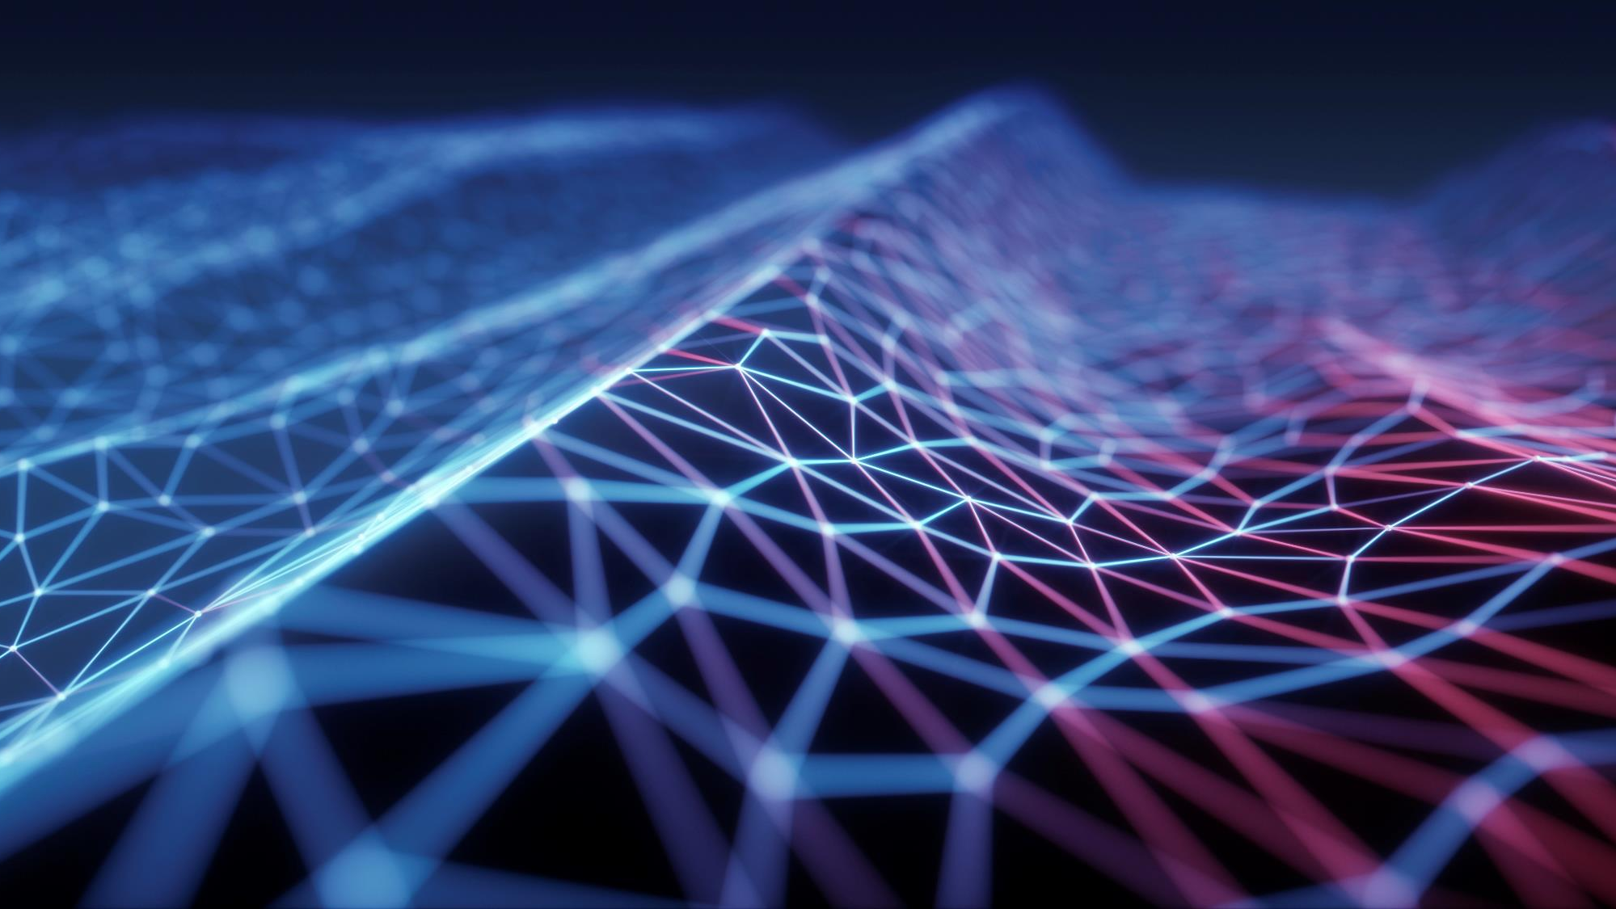
Exploration for Wayfarer
Guided By: Presented by:
Prof. Himani Trivedi Patel Deep R. (19BEIT30010)
Prajapati Dhvanil N. (19BEIT30016)
Kothari Jainam G. (19BEIT30027)
Bunha Kunj C. (19BEIT30038)

Slide 2
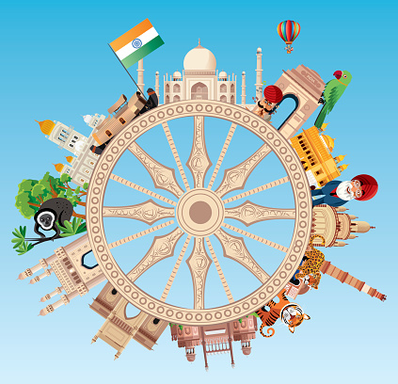
Table Of Content
Introduction
Objectives
Scope
Flow of System
Technology
Screenshots
Future Work

Slide 3
Introduction
Tourism industry is one of the major contributor to the national development.
India having a rich culture and history attracts the tourists around the world to visit various monuments, historical places, museums, etc.
But due to the pandemic, the Indian tourist sector had a major setback.
“Exploration for wayfarer“ can be used to revive the tourism sector of India.

Slide 4
Objectives
To create a User Interface (UI) with database interaction, through which tourists can register themselves.
To create and manage the database of all the historical places and museums across the country.
To develop an E-ticket generation system, to create a QR based entry ticket.
To predict the number of tourists visiting any tourist place at any time of the year.

Slide 5
Scope
The web portal can be used to generate e-tickets for tourist places.
It also allows the government to monitor the travelling history of any individual of the country.
With the help of this portal, government can predict the number of tourists to any place.
The web portal aids the government to manage the resources in an efficient manner.

Slide 6


Flow of System
There are two modules in this system.
Admin
Manage the historical places details and the prices of ticket.
Develop the report of the tourists travelling history.
Tourists
Find details of the places to visit based on their interests.
Book themselves to visit any tourist place.

Slide 7
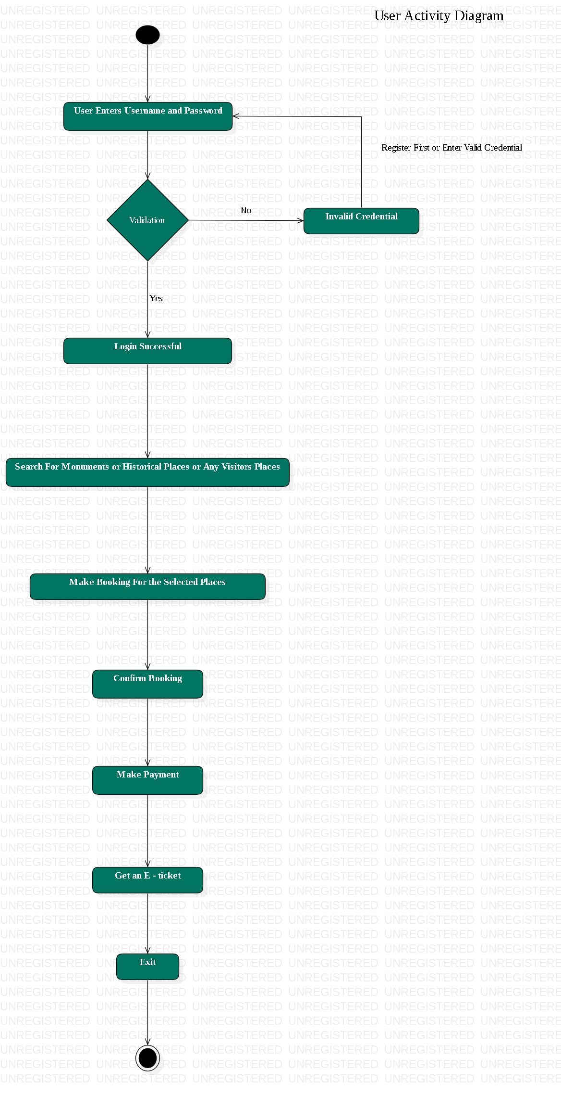
Fig: User Activity Diagram

Slide 8
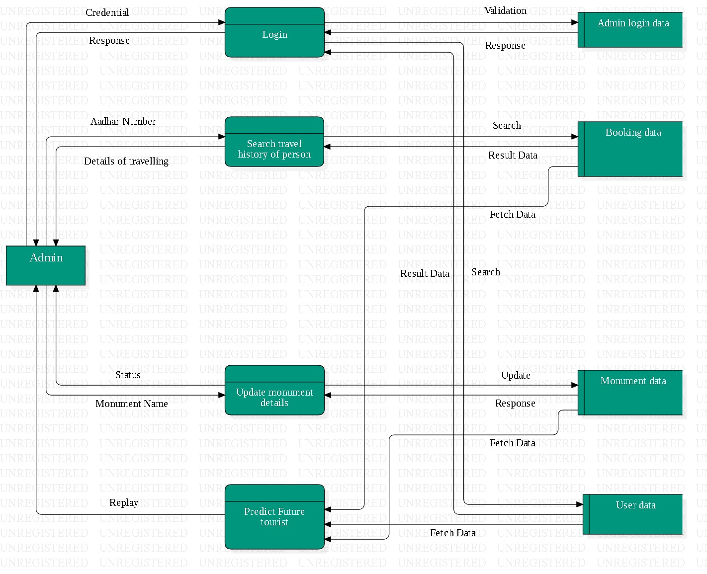
Fig: Admin Data Flow Diagram

Slide 9
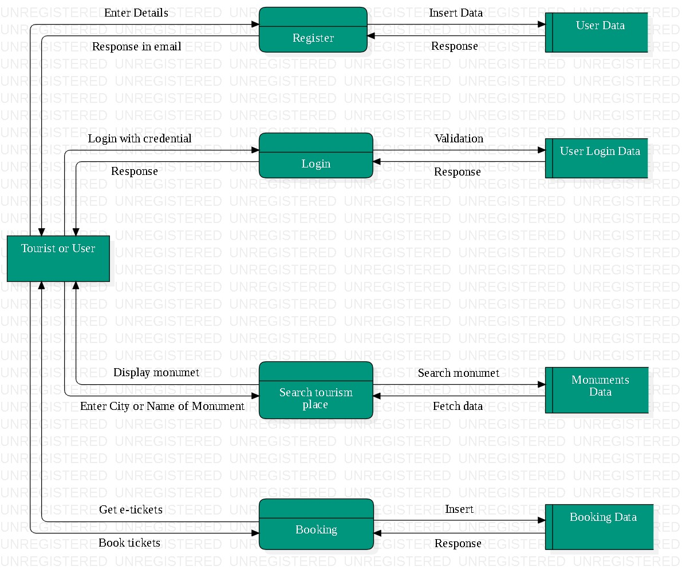
Fig: Tourist Data Flow Diagram

Slide 10

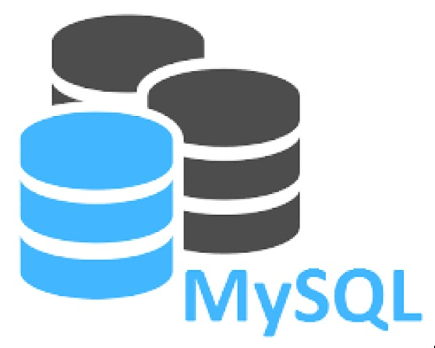
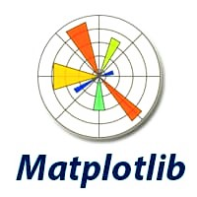

Technology
To develop the user interface, Flask framework of Python is used.
MySQL database is used to store and manage the information.
The sklearn library is used to predict the number of tourists.
The library used to visualize the charts is matplotlib.

Slide 11
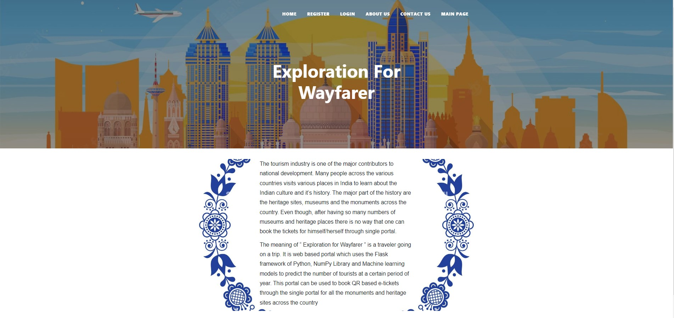
Screenshots

Slide 12
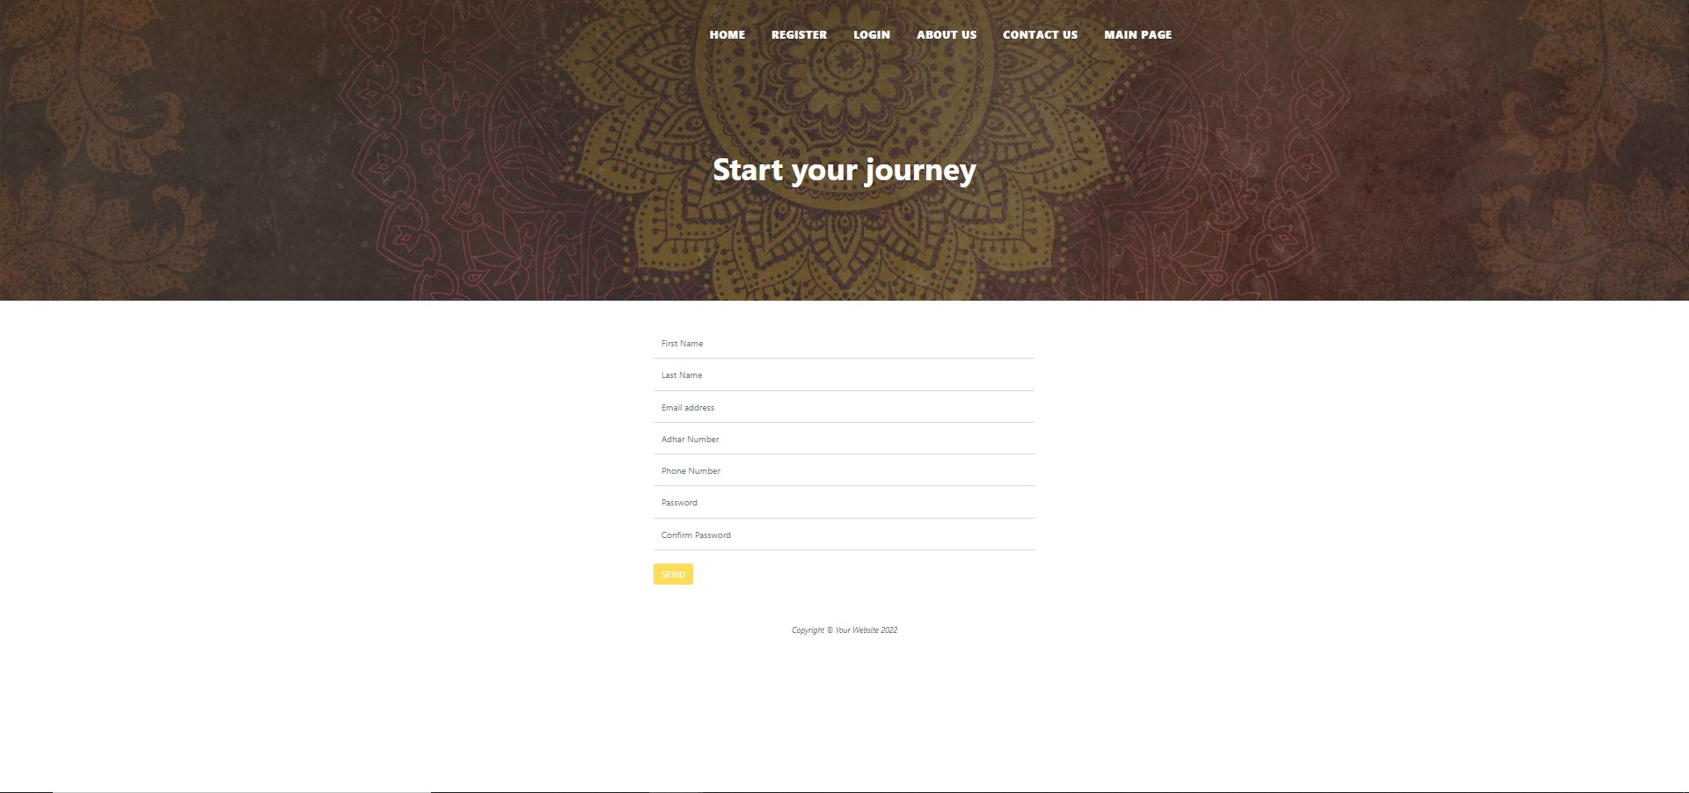

Slide 13
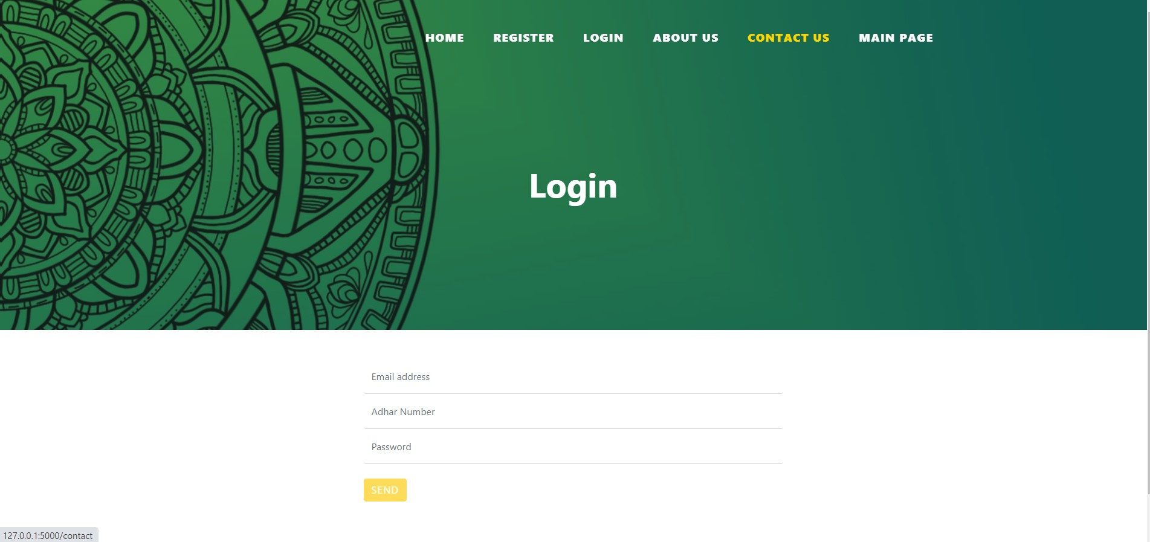

Slide 14
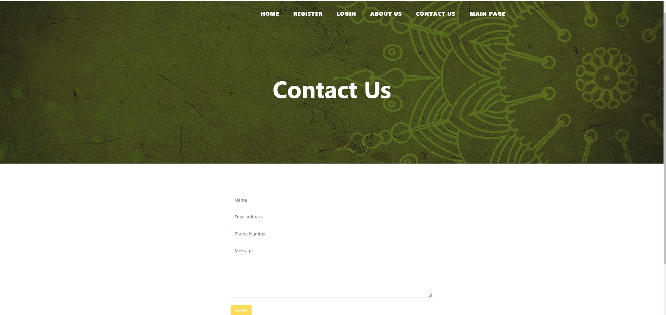

Slide 15
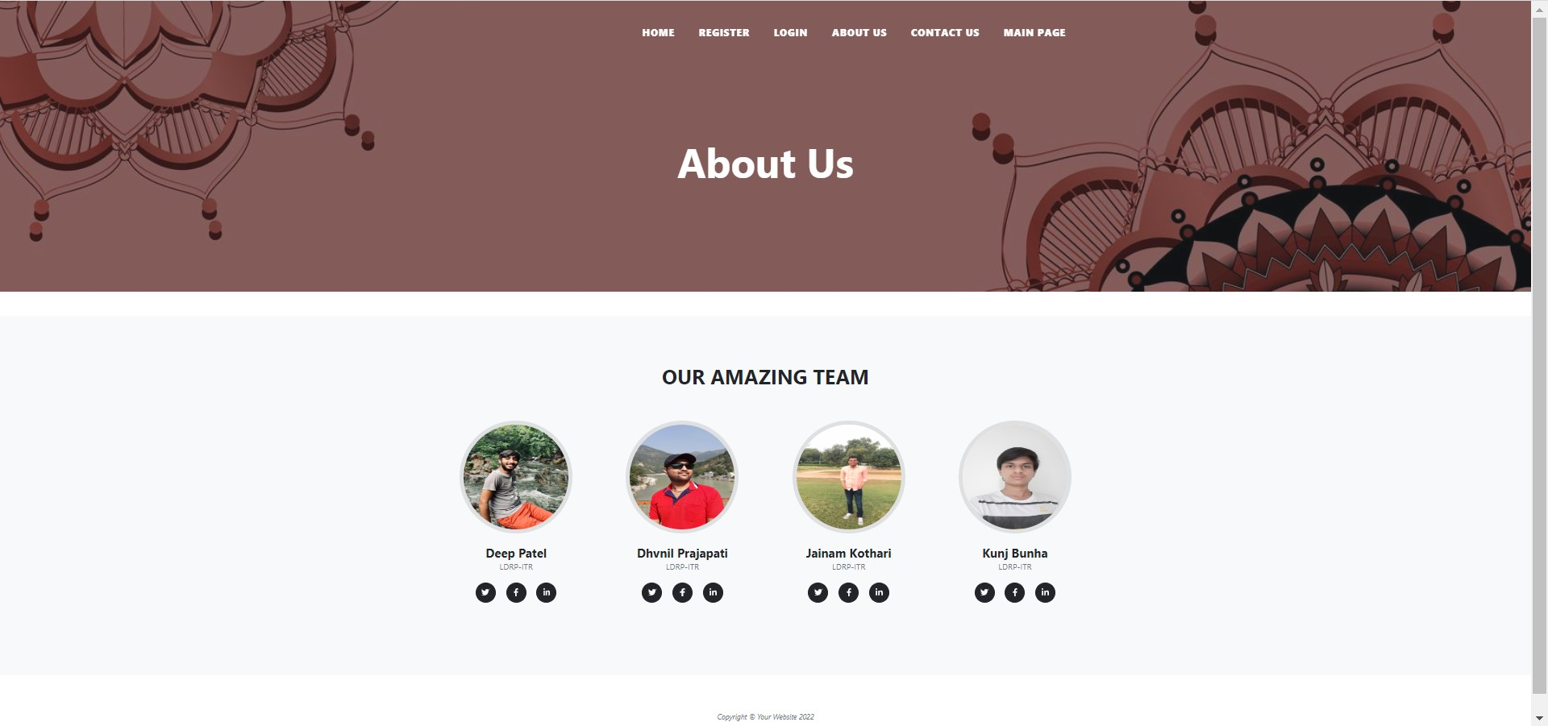

Slide 16
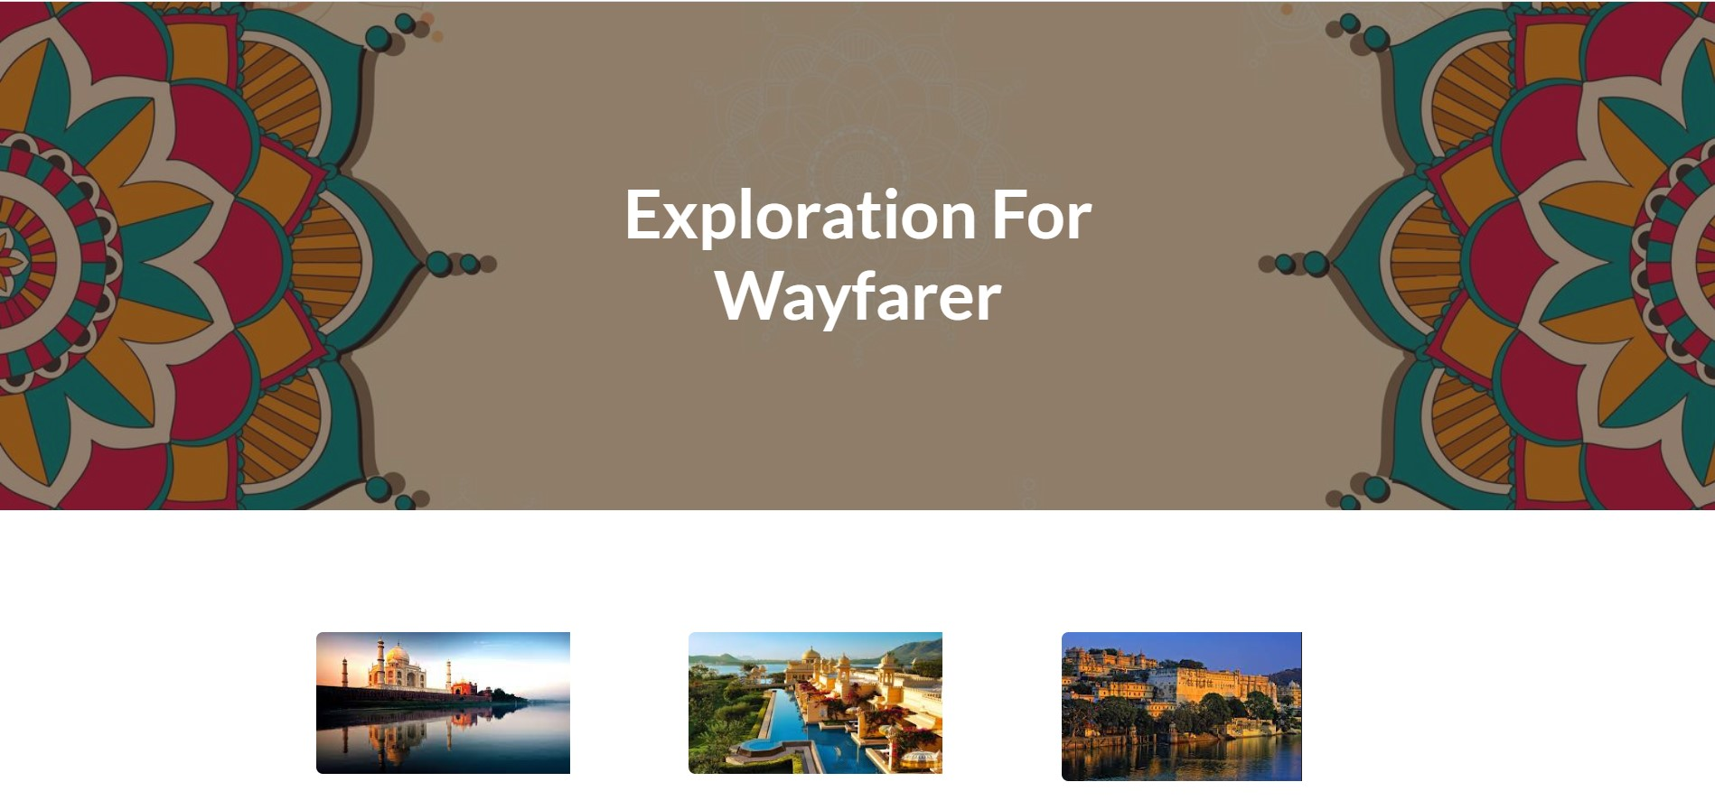

Slide 17
Future Work
To add graphs showing number of tourists to any place.
To develop a recommendation system which recommends tourist places to tourists.
To train a machine learning model to predict number of tourists at tourist places.
To create a QR-based ticket and send it as an email to registered email.

Slide 18
Thank YOU
Open for Questions and Suggestions.

